Slide 1
Problem solving techniques
(Algorithm ,Flowchart , Pseudocode)
-Pranali Chougule

Slide 2
Algorithm
An algorithm is a step-by-step procedure or formula for solving a problem.
It describes the sequence of actions to be executed to achieve a result.
An algorithm basically means how to solve a problem.
First, we need to learn a few analytical or problem-solving skills to write an algorithm.

Slide 3
Basic Requirements for algorithm
Finiteness: Must terminate after a finite number of steps.
Definiteness: Every step is precisely defined.
Input: Takes zero or more inputs.
Output: Produces at least one output.
Effectiveness: Each step is simple and executable.
Correctness: The algorithm solves the problem correctly.
Generality: It applies to a wide range of problems or inputs.

Slide 4
Example of Algorithm
Problem: Find the largest number in a list.
Start.
Assume the first number in the list is the largest.
Compare this number with the next number in the list.
If the next number is larger, update the largest number.
Repeat the process until the entire list is traversed.
Output the largest number.
Stop.

Slide 5
Flowchart
A flowchart is a diagrammatic representation of an algorithm.
As series of interrelated functional blocks, each of which corresponds to the implementation one or more actions.
Flowchart Symbols:
Oval: Start/end
Rectangle: Process (e.g., Calculations)
Diamond: Decision (e.g., Yes/no)
Arrow: Flow of control

Slide 6
Types Of Flowchart
Document flowcharts: Showing controls over a document-flow through a system
Data flowcharts: Showing controls over a data-flow in a system
System flowcharts : Showing controls at a physical or resource level
Program flowchart: Showing the controls in a program within a system

Slide 7
Example of Flowchart
Start
Get a,b
Problem: Find the largest number
In two numbers
Is (a>b)
yes
No
A is greatest
B is greatest
Stop

Slide 8
Pseudocode
Pseudocode is an informal way to describe the steps of an algorithm in plain language or structured code-like syntax.
Pseudocode generally does not actually obey the syntax rules of any particular language; there is no systematic standard form.
It's meant to be human-readable and is not a strict programming language.

Slide 9
Example of Pseudocode
Problem :Finding the largest number
Start
Set largest = first element of the list
For each element in the list
If element > largest
Set largest = element
End If
End For
Print largest
End

Slide 10
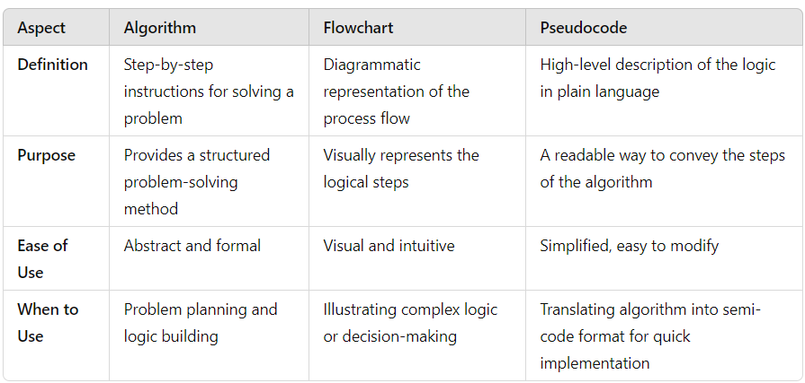
Comparison between algorithm,flowchart,pseudoc0de

